Slide 1


15/02/2023 Topic: Land degradation
Do now activity
Grab an EXIT Ticket- complete and hand in
Bags outside and caps off
Exercise books and stationary on the desk
Copy down the LI and SC in your exercise books
Learning intentions (LI) Able to describe the impacts of land degradation and competing demands for land on food security
Success criteria (SC) Able to discuss and explain land degradation and the impacts.

Slide 2
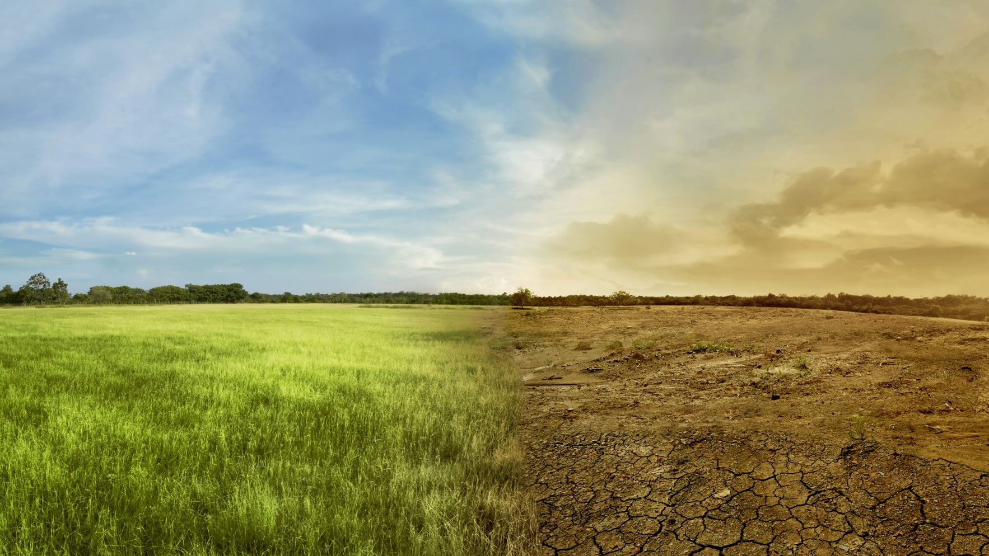
Glossary:
Desertification: the process by which vegetation in drylands i.e. arid and semi-arid lands, such as grasslands or shrublands, decreases and eventually disappears.
Marginal land : land that has little or no agricultural or industrial value.

Slide 3
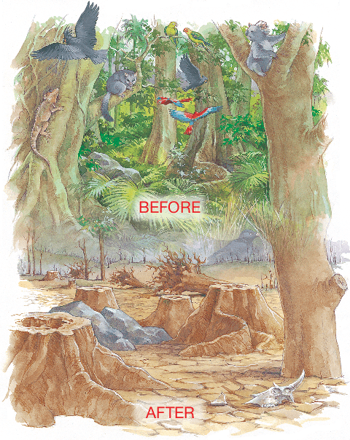
What causes land degradation?
Land can be degraded in many ways, but most of the causes can be traced back to the influences of human activity on the natural environment. Degradation is the process that reduces the lands capacity to produce crops, support natural vegetation and provide fodder for livestock. Land degradations causes physical, chemical and biological changes; the natural environment deteriorates and the landscape undergoes dramatic changes. Common causes of land degradation include soil erosion, increased salinity, pollution and desertification.

Slide 4
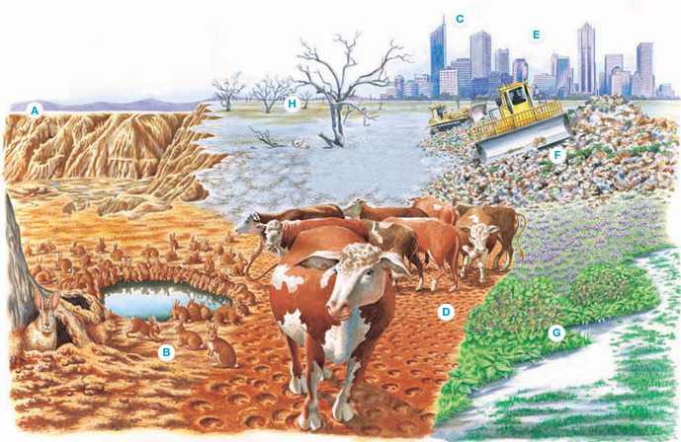
a. Erosion
When land is cleared or overgrazed, it becomes vulnerable to erosion by wind and water. The nutrient-rich soil is either washed or blown away, reducing the quality and quantity of crop yields. Dust storms result and sediment is transported to rivers, where it can smother marine species.

Slide 5
b. Introduced animal species
Introduced species such as rabbits eat grass, shrubs and young trees (saplings) down to the soil, thus exposing it to erosion. Their burrows increase erosion as they destabilise the soil. Rabbits also compete with native animals for food and burrows.

Slide 6
c. Tourism
Tourism encourages the clearing of sand dunes for high-density housing, and mountain slopes for ski runs, leaving the surface exposed to erosion.

Slide 7
d. Overgrazing
Overgrazing leads to nutrient –rich soil being washed away. Animals with hard hoofs such as sheep and cattle trample vegetation and compact the soil. This leads to increased run off after rain.

Slide 8
e. Climate Change
Climate change will affect land degradation in the future. Higher sea levels will flood low-lying coastal areas. Expanding cities, removal of vegetation and use of concrete reduces the ability of the land to absorb moisture. This not only increases erosion, but can reduce the amount of rainfall in an area.

Slide 9
f. Urban living
Urban communities produce large quantities of waste, which is deposited in landfills. Much of the rubbish remains toxic or, in the case of plastic bags, takes hundreds of years to break down. Liquid and solid waste seeps into groundwater and runs off into rivers and eventually into the sea, killing marine species.

Slide 10
g. Introduced plant species
Introduced plant species such as blackberries and Paterson’s Curse (Salvation Jane) choke the landscape and compete with native vegetation. Their dense groundcover prevents light from reaching the soil.

Slide 11
h. Salinity
Salinity occurs naturally in areas where there is low rainfall and high evaporation and also where the land was below sea level millions of years ago. Salinity is also caused by excess irrigation and clearing natural vegetation. In some cases the water table rises, bringing salt to the surface.

